Slide 1
CREATE TABLE LETCRUD2
(
CRUD_SJ VARCHAR(100) NULL,
CRUD_ID CHAR(10) NOT NULL,
CRUD_CN TEXT NULL,
USER_NM VARCHAR(20) NULL,
FRST_REGIST_PNTTM DATETIME NULL
);
ALTER TABLE LETCRUD2
ADD PRIMARY KEY (CRUD_ID);
ALTER TABLE LETCRUD2 COMMENT = 'CRUD테이블';
ALTER TABLE LETCRUD2 CHANGE COLUMN CRUD_ID CRUD_ID CHAR(10) NOT NULL COMMENT 'CRUDID';
ALTER TABLE LETCRUD2 CHANGE COLUMN CRUD_SJ CRUD_SJ VARCHAR(100) NULL COMMENT '제목';
ALTER TABLE LETCRUD2 CHANGE COLUMN CRUD_CN CRUD_CN TEXT NULL COMMENT '내용';
ALTER TABLE LETCRUD2 CHANGE COLUMN USER_NM USER_NM VARCHAR(20) NULL COMMENT '작성자';
ALTER TABLE LETCRUD2 CHANGE COLUMN FRST_REGIST_PNTTM FRST_REGIST_PNTTM DATETIME NULL COMMENT '작성일';

Slide 2
INSERT INTO ids
(TABLE_NAME, NEXT_ID)
VALUES('ESNTL_ID', 1);
<!-- JOIN START-->
<bean name="joinIdGnrService" class="egovframework.rte.fdl.idgnr.impl.EgovTableIdGnrServiceImpl"
destroy-method="destroy">
<property name="dataSource" ref="egov.dataSource" />
<property name="strategy" ref="joinStrategy" />
<property name="blockSize" value="10"/>
<property name="table" value="IDS"/>
<property name="tableName" value="ESNTL_ID"/>
</bean>
<bean name="joinStrategy" class="egovframework.rte.fdl.idgnr.impl.strategy.EgovIdGnrStrategyImpl">
<property name="prefix" value="ESNTL_" />
<property name="cipers" value="14" />
<property name="fillChar" value="0" />
</bean>
<!-- JOIN END-->

Slide 3
pom.xml
<dependency>
<groupId>net.sf.json-lib</groupId>
<artifactId>json-lib</artifactId>
<version>2.4</version>
<classifier>jdk15</classifier>
</dependency>
message-common.properties(메세지파일 전부)
#회원가입
fail.duplicate.member = 이미 사용중인 ID입니다.
join.request.msg=회원신청이 정상적으로 완료되었습니다. 로그인 후 이용해 주세요.

Slide 4
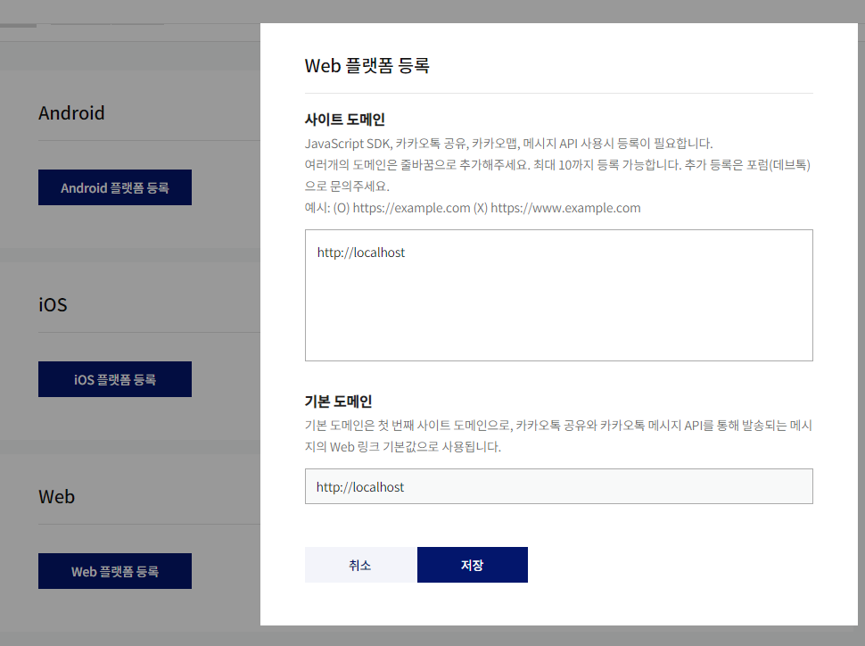
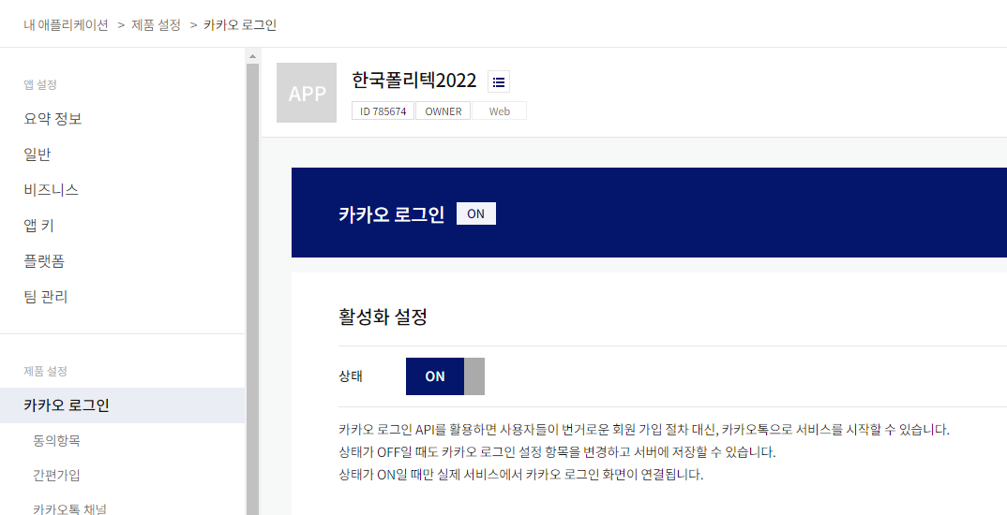
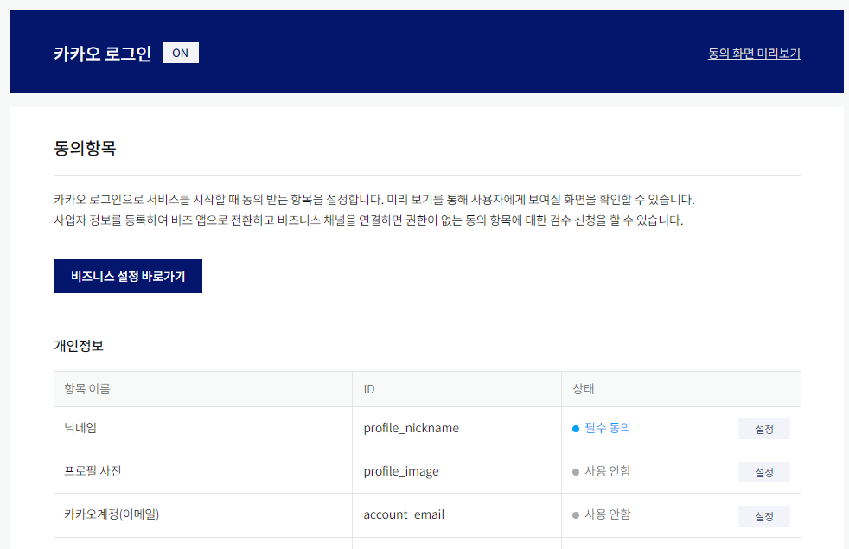
카카오개발자 사이트 URL : https://developers.kakao.com/

Slide 5
LoginVO
/** 로그인타입 */
private String loginType;

